Slide 1
IDEA Project
Matt Okeefe

Slide 2
Percentage of Disabilities by Race
Percentage distribution of students with disabilities
Percentage of students with disabilities by race/ ethnicity

Slide 3
Services
IDEA – Special Education law of the nation – It protects individuals with disabilities
Schools Must find and evaluate students that have a disability at no cost to the family
Schools must provide services for any student that is deemed special needs or has a disability that falls under one of the 13 categories
If a school can not provide adequate services, the school district must pay for that student to have proper services elsewhere

Slide 4
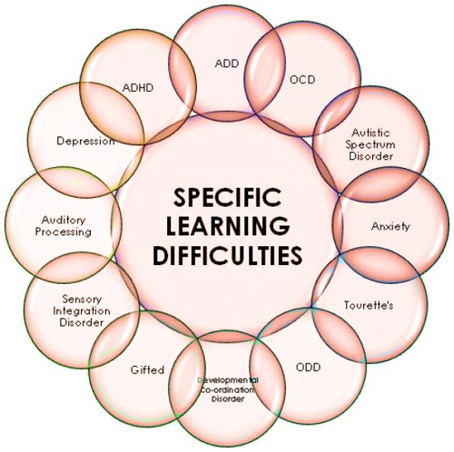
What is a Learning Disability
Learning disabilities are disorders that affect the ability to understand or use spoken or written language, do mathematical calculations, coordinate movements, or direct attention. Although learning disabilities occur in very young children, the disorders are usually not recognized until the child reaches school age.
8 to 10 percent of American children under 18 years of age have some type of learning disability.
Learning Disabilities are group into 13 different categories

Slide 5
Facts about Learning Disabilities in Schools
In 2018-2019, 7.1 Million students ranging from ages 3-21 received special education services under the IDEA act. That’s roughly 14 percent of public school students receiving services and 33 percent of those students had a specific learning disability.
Over the last ten years students receiving services has increased from 6.4 million to 7.1 million.

Slide 6
Free Education Resources
https://do2learn.com/
This website is a great tool for any teacher, or parent. It has a variety of resources that can be accessed. It even has PECS cards which is a way nonverbal kids communicate.

Slide 7
Story Line Online
https://www.storylineonline.net/books/fast-words-fly/
This website, has a variety of children’s books that are read aloud via youtube and other platforms.
So if a student can not read, they can listen to the book instead

Slide 8
Apps
https://www.readingrockets.org/blogs/aiming-access/16-apps-websites-including-students-disabilities-stem-education
This website has a ton of apps that allow students to read, listen to podcast, has a visual dictionary and so much more

